Slide 1


Enterprise Blockchain
-- Alternative Consensus
LING Zong, Ph. D.
Senior Software Engineer / Scientist
IBM Almaden Research Center
San Jose, California, U.S.A.
Notes:
# It's important to cover the history of Bitcoin so that you can understand the backgrounds and motivations of the people running the industry today.
# First, we'll cover the most basic concepts relating to Bitcoin - you'll hear these over and over again, and then I'll outline the history covered in this lecture before we dive in.
# Note that this lecture is not very representative - the rest of the course is going to be a lot more technical.

Slide 2
Alternative Consensus
-Alternative consensus: other methods of verification other than proof of work (PoW).
-Created after downsides of PoW discovered:
Massive electricity devouring
Total performance in 2012 surpassed the most productive supercomputer
Notes:
devour v. (尤指因饥饿而) 狼吞虎咽地吃光; 津津有味地看; 如饥似渴地读; 吞没; 吞噬; 毁灭;

Slide 3
Proof of Stake (PoS)
PoS requires users to provide ownership stake in currency, i.e. PeerCoin.
Saves energy vs. proof of work methodology, lowering computing processes and power required.
Stake in currency provides “collateral” of trust in network and block creation.
Higher the stake, higher the collateral.
With Proof of Work, the probability of mining a block depends on the work done by the miner (e.g. CPU/GPU cycles spent checking hashes).
With Proof of Stake, the resource that's compared is the amount of Bitcoin a miner holds - someone holding 1% of the Bitcoin can mine 1% of the "Proof of Stake blocks".
--https://en.bitcoin.it/wiki/Proof_of_Stake
Notes:
Cons of PoS, not as secure and why. Why PoS will fail. Google “world hashgram attacks civil”. Proof-of-burn (and other permission-based consensus systems). Connection to Tobias, private blockchain. Proof-of-storage. Random oracle model. Proof-of-activity
Collateral n.担保物; 旁系亲属;

Slide 4
Proof of Activity (PoA)
Hybrid between PoS and PoW. PoW mechanisms used as checkpoints for block creation.
Blocks are generated through PoW methods, with PoS-type signatures to certify blocks.
Just a theory, little development.
Proof of activity adds a second line of defense against 51% attacks because an attacker would theoretically need to have both 51% or more of the network's total mining power and 51% or more of the coins staked in the network in order to successfully pull off the attack.
Notes:
https://golden.com/wiki/Proof-of-activity_(PoA)

Slide 5
Proof of Burn (PoB)
Proof of burn is a method for distributed consensus and an alternative to Proof of Work and Proof of Stake. It can also be used for bootstrapping one cryptocurrency off of another.
The idea is that miners should show proof that they burned some coins - that is, sent them to a verifiably unspendable address. This is expensive from their individual point of view, just like proof of work; but it consumes no resources other than the burned underlying asset. To date, all proof of burn cryptocurrencies work by burning proof-of-work-mined cryptocurrencies, so the ultimate source of scarcity remains the proof-of-work-mined "fuel".
There are likely many possible variants of proof of burn. (https://en.bitcoin.it/wiki/Proof_of_burn)
Lottery system where coins are burned to win chance of mining a block.
Digital coins deposited do not burn until accepted for block rewards.
Notes:
https://en.bitcoin.it/wiki/Proof_of_burn

Slide 6
Proof of Elapsed Time (Cryptocurrency)
Proof of elapsed time (POET) is a blockchain network consensus mechanism algorithm
  prevents high resource utilization and high energy consumption
  keeps the process more efficient by following a fair lottery system.
Each participating node in the network is required to wait for a randomly chosen time period, and the first one to complete the designated waiting time wins the new block.
Each node in the blockchain network generates a random wait time and goes to sleep for that specified duration.
The one to wake up first – that is, the one with the shortest wait time – wakes up and commits a new block to the blockchain, broadcasting the necessary information to the whole peer network
The same process then repeats for the discovery of the next block.
https://www.investopedia.com/terms/p/proof-elapsed-time-cryptocurrency.asp

Slide 7
Solo
Solo mining is a solo process where the miner completely does his task of mining operations without any helping hand.
This process is mainly done alone without joining a pool.
These blocks are mined and generated in a way to the task completed by the miner’s credit.
https://www.blockchain-council.org/blockchain/solo-mining-works/

Slide 8
ZooKeeper
ZooKeeper is a centralized service for maintaining configuration information, naming, providing distributed synchronization, and providing group services. All of these kinds of services are used in some form or another by distributed applications.
Each time they are implemented there is a lot of work that goes into fixing the bugs and race conditions that are inevitable. Because of the difficulty of implementing these kinds of services, applications initially usually skimp on them ,which make them brittle in the presence of change and difficult to manage. Even when done correctly, different implementations of these services lead to management complexity when the applications are deployed.
ZooKeeper aims at distilling the essence of these different services into a very simple interface to a centralized coordination service. The service itself is distributed and highly reliable.
Consensus, group management, and presence protocols will be implemented by the service so that the applications do not need to implement them on their own. Application specific uses of these will consist of a mixture of specific components of Zoo Keeper and application specific conventions. ZooKeeper Recipes shows how this simple service can be used to build much more powerful abstractions.
https://cwiki.apache.org/confluence/display/ZOOKEEPER/Index/
Notes:
brittle adj. 硬但易碎的; 脆性的; 脆弱的; 尖利的; 刺耳的; Skimp v.节省，吝惜(时间、钱等);

Slide 9
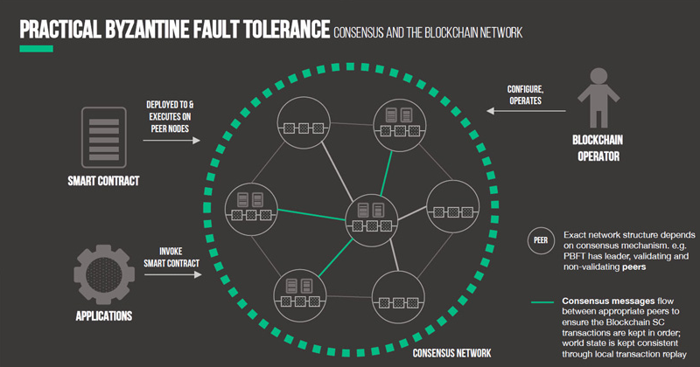
Practical Byzantine Fault Tolerance(PBFT)
The PBFT model primarily focuses on providing a practical Byzantine state machine replication that tolerates Byzantine faults (malicious nodes) through an assumption that there are independent node failures and manipulated messages propagated by specific, independent nodes.
The algorithm is designed to work in asynchronous systems and is optimized to be high-performance with an impressive overhead runtime and only a slight increase in latency.
Essentially, all of the nodes in the PBFT model are ordered in a sequence with one node being the primary node (leader) and the others referred to as the backup nodes.
All of the nodes within the system communicate with each other and the goal is for all of the honest nodes to come to an agreement of the state of the system through a majority.
Nodes communicate with each other heavily, and not only have to prove that messages came from a specific peer node, but also need to verify that the message was not modified during transmission.
https://blockonomi.com/practical-byzantine-fault-tolerance/

Slide 10
Byzantine Generals Problem
Background:
-Consensus decision made by all generals. Traitorous generals can sabotage plan, also send out purposeful miscommunication.
-If there’s a tie, the final (traitorous) general can send two separate messages.
-Physical separation.
-(Null), or no response, can have predefined value (retreat).
-Generals are computers, messengers are digital communication systems.
Notes:
Double spending problem. Half-majority solution to ⅓ traitors -Add more on byzantine fault.

Slide 11
Byzantine Fault Tolerance
Mechanics:
-Impossible to solve if ⅓ or more of generals are traitorous.
-Most difficult of failure modes in fault-tolerant computer systems. Not a fail-stop mechanism.
-Direction of “truth” as network grows → more difficult to oppose (Satoshi white paper: final section).
-Applies to hashcash mechanism used in bitcoin.

Slide 12
Alternative Consensus
Ripple:
-Payment protocol, trading with fiat currency and Ripple currency (XRP).
-Infrastructure for payments between financial institutions and “market makers”.
-Rippled trust system, makes use of internal ledger. All assets are held as debt obligations.
Notes:
Fiat n.(当权者的) 法令，命令，谕;

Slide 13


Ripple
Ripple allows banks to think differently about the payment world.
Let’s watch the video!
How Ripple Works.mp4

Slide 14
Alternative Consensus
Video: how-money-moves-on-stellar.mp4
Stellar
-Payment system with better technology than Ripple. More peer-to-peer use.
-Accounts stored in ledger, with network of computers creating global value exchange network.
-Selected public trustworthy nodes, use of quorum slices to create ripple effect.
-Two to four second constant consensus. ~80% consensus.

Slide 15
“Enterprise” Blockchain
Notes:
A Blockchain is a distributed database for transaction processing.

Slide 16
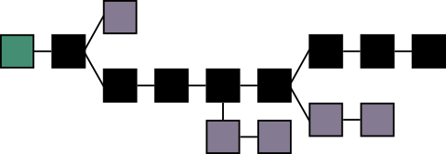


Blockchain
Blockchain 1.0 - Currency
Bitcoins
Altcoins
IoM (Internet of Money)
Blockchain 2.0 - Contracts
Smart Property
Smart contracts (Programmable money)
Dapps, DAOs, DACs, DASs
Notes:
In order to understand the revolution/development of the blockchain it is important to know where we are now with the blockchain and what we could expect in the future. The different blockchain phases will be highlighted here, 1.0,2.0,3.0

Slide 17
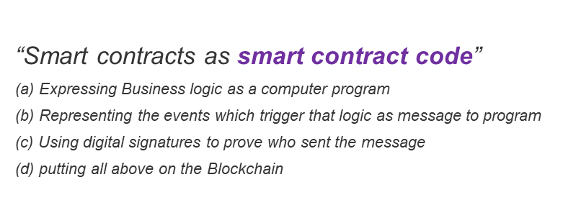
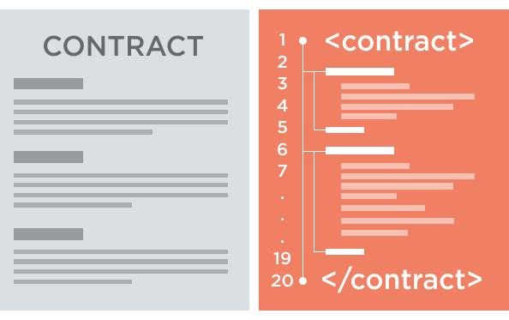




“Smart contracts as smart contract code”
Blockchain
Block 0
Block 1
Contract
Contract code
Block 2
Timestamp
Block
Signature
Notes:
Basically what a smart contract does is that it transforms the terms on the contract into code so that they are executable via code. Besides this it is possible to manage the terms. For example, you make a contract that as soon as you receive the money we sent the product. Currently most of this is performed by hand, but with a smart contract it is possible that he self execute the terms.
Every can agree on the initial contract, the entire system can come to entire consensus without human intervention.
Where Smart Contracts are really big at the moment is in the financial where they used it to program negociating terms in the code and the code can self execute it’s tasks.
The different definitions usually fall into one of two categories. Sometimes the term is used to identify a specific technology – code that is stored, verified and executed on a blockchain. Let’s call this type of definition “smart contract code”.
– pre-written logic (computer code),
– stored and replicated on a distributed storage platform (eg a blockchain),
– executed/run by a network of computers (usually the same ones running the blockchain),
– and can result in ledger updates (cryptocurrency payments, etc).– pre-written logic (computer code),
– stored and replicated on a distributed storage platform (eg a blockchain),
– executed/run by a network of computers (usually the same ones running the blockchain),
– and can result in ledger updates (cryptocurrency payments, etc).

Slide 18




Smart Contract - Example
Alice
Bob
Tobias
Max

Slide 19


Smart Contract - Example
Alice
Bob
So if Max wants to make a change the whole chain gets a message. Everybody needs to approve.
Tobias
Max

Slide 20


Smart Contract - Example
Alice
Bob
Tobias
Max

Slide 21
Pros / Cons
Pros:
- It is secure
  if somebody wants to change a contract everybody gets a warning
- Self executing,
- Distributed/Decentralized
- M2M (Machine to Machine)
Cons:
- Scalability of the chain
- Difficult for legal contracts, which need human interpretation
- Computation power
- Difficult to update a smart contract

Slide 22
Dapps, DAOs, DACs, DASs
Decentralized applications (Dapps)
- It is an application that runs on a network in a distributed fashion with participant information securely protected and operation execution decentralized across network nodes.
Decentralized Autonomous Organizations & Corporations (DAOs & DACs)
- In a DAO/DAC, there are smart contracts as agents running on Blockchains that execute ranges of prespecified or preapproved tasks based on events and changing condition.
- Storj, Smart Contracts operated, decentralized file storage
Decentralized Autonomous Societies (DASs)
- In the future this can be a DAS where a fleet of smart contracts, or entire ecosystems of Dapps, DAOs, DACs operating autonomously

Slide 23

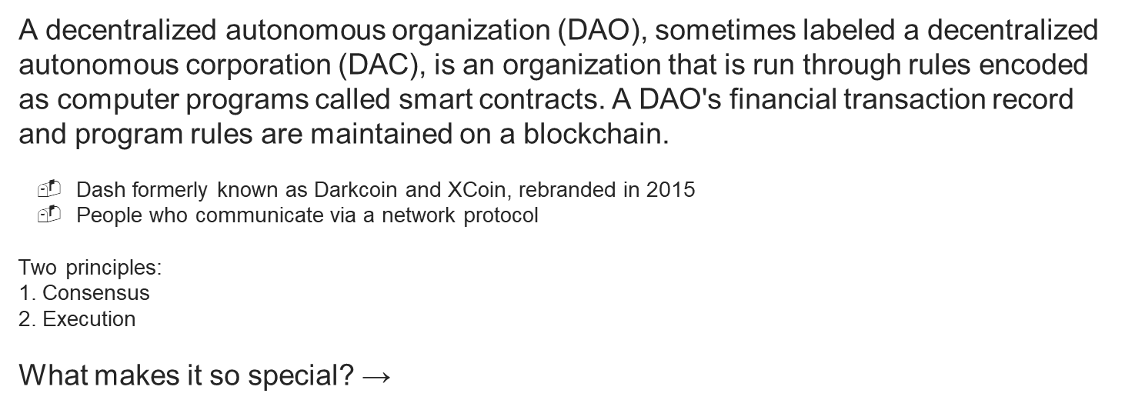
DAO - DASH
Reward
45%
45%
10%
Miners
-
Generate the Blockchain
Masternodes
-
Privatesent
Instant sent
All other Job that is necessary
Notes:
Compared to the Bitcoin DAO Dash it’s reward system to give to miners is completely different. Instead of 100% of the coins go to the miners it is splitted up in three different fields.
The Masternodes can autonomously vote on improvements regarding Dash and execute it.

Slide 24
Blockchain
Blockchain 1.0 - Currency
Bitcoins
Altcoins
IoM
Blockchain 2.0 - Contracts
Smart Property
Smart contracts (Programmable money)
Dapps, DAOs, DACs, DASs
Blockchain 3.0 - Justice applications (Beyond currency, economics and market)
New model of organizing (consensus)
Digital ID Verification
IP Protection
Media Management
Virtual Notary, Bitnotar, Chronobit
Government and Healthcare
Notes:
In order to understand the revolution/development of the blockchain it is important to know where we are now with the blockchain and what we could expect in the future. The different blockchain phases will be highlighted here, 1.0,2.0,3.0
1.0
2.0
Blockchain 3.0 -
It is not just a better way of organizing your organizational model functionality, practically and quantitatively; by requiring consensus to operate, the model could also have greater liberty, equality, and empowerment qualitatively. Thus, the blockchain is a complete solution integrates both extrinsic and intrinsic and qualitative and quantitative benefits.

Slide 25



Applications
What do we mean by enterprise blockchain?
Healthcare
Patient registration
Fake pharmaceuticals
Medical Research data
Government
ID Registration
Tax payments
Finance & Investments
Transactions
Trade Finance
Commodity trading
Internal transactions
Cross Boarder
Notes:
What do we mean by enterprise blockchain?
A blockchain that completely manages certain parts of an organization think about CRM or Invoicing Systems. The blockchain can eventually take over contracts management systems and other types of large software. For the above three industry the blockchain is incredibly helpful for managing their information. Security plays here a large part.

Slide 26




Healthcare - user cases
Let’s apply blockchain to Healthcare.
Video: how-blockchain-can-streamline-healthcare.mp4
Medical records
Notes:
Imagine your own personal data on the blockchain regarding healthcare.
Could not find a good user case so i came up with one of myself:
Currently all the medical records are either paper or centrally stored on one database where you don’t have any insights in your own records and what is going on. Every Time you visit the doctor you need to tell them the same story. Imagine your records safely on a blockchain hashed with a special QR code so when you come to the doctor you just let him scan the code and he has your records and during the meeting he asks you to make changes and you can allow him to and nobody else.

Slide 27
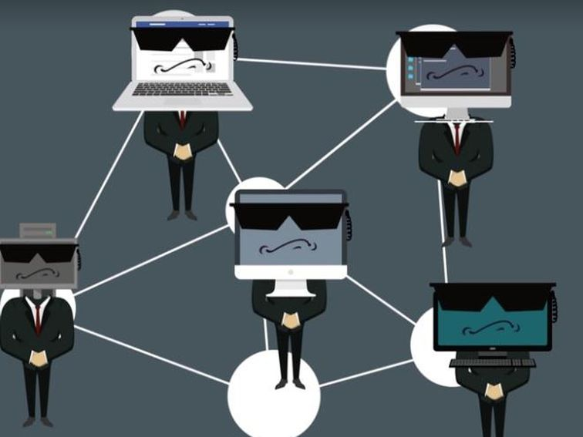
Government - user cases
Let’s apply blockchain to government.
Video: blockchain-for-government-services.mp4
Notes:
Imagine your own personal data on the blockchain regarding healthcare.
Could not find a good user case so i came up with one of myself:
Currently all the medical records are either paper or centrally stored on one database where you don’t have any insights in your own records and what is going on. Every Time you visit the doctor you need to tell them the same story. Imagine your records safely on a blockchain hashed with a special QR code so when you come to the doctor you just let him scan the code and he has your records and during the meeting he asks you to make changes and you can allow him to and nobody else.

Slide 28
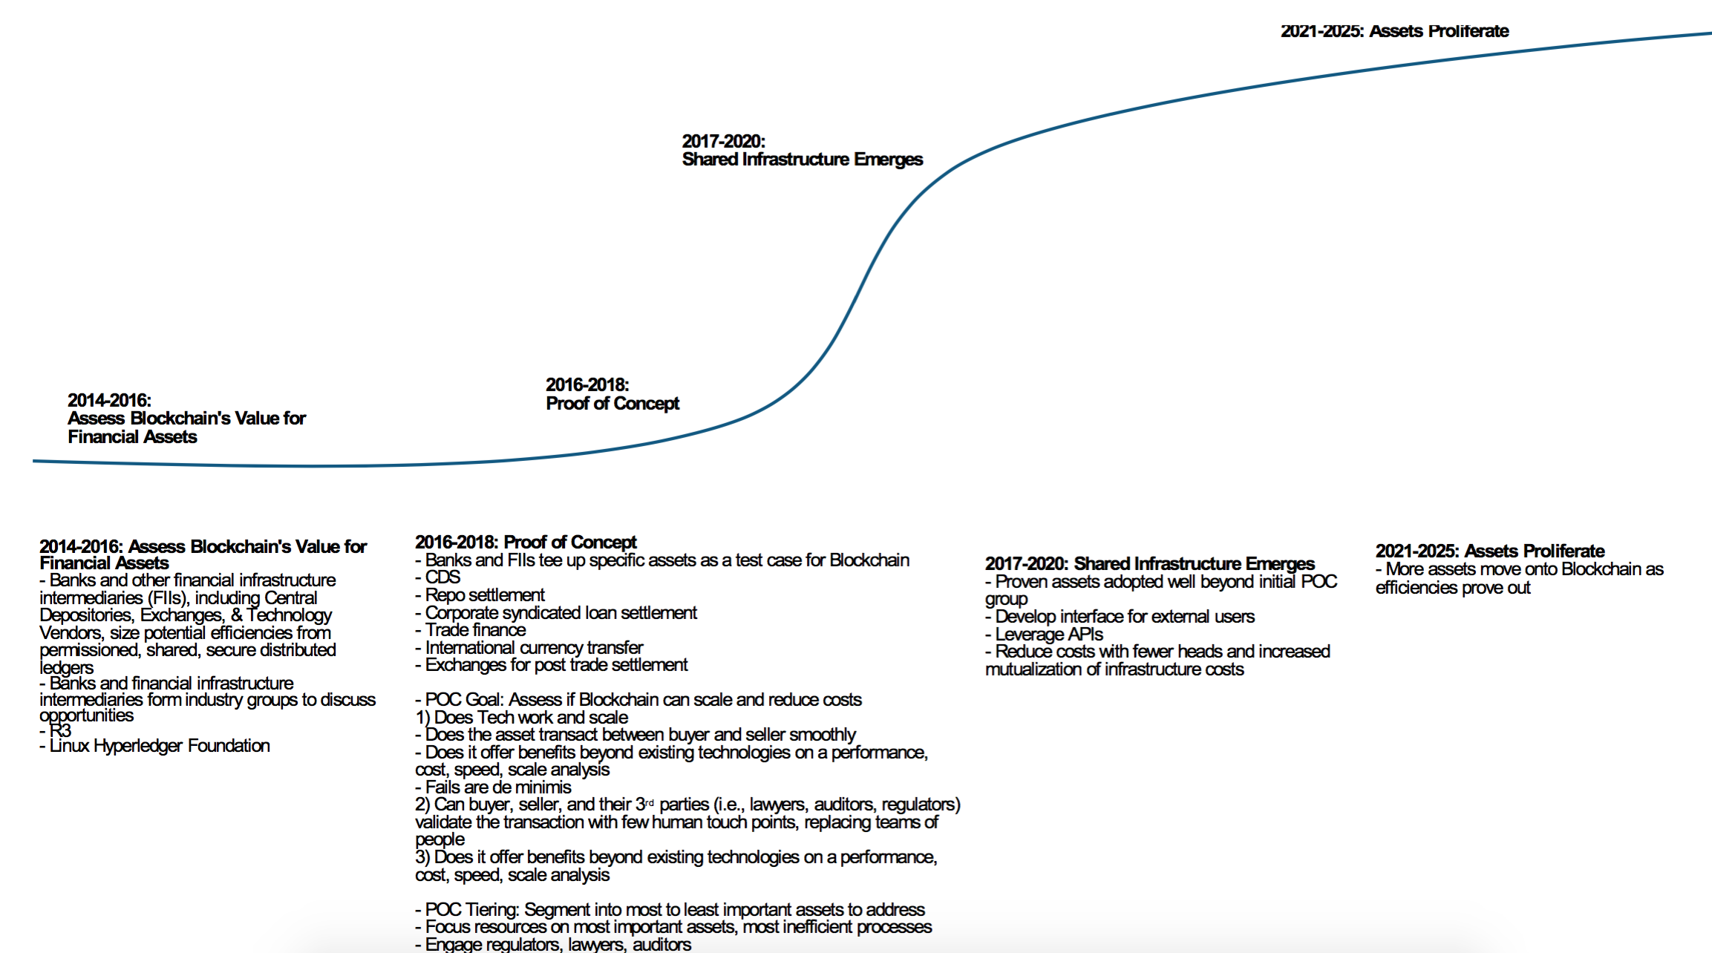
The future
What to expect?....
Notes:
Morgan stanley report

Slide 29
Private vs. Open blockchains

Slide 30
Blockchains…
Public Blockchain - A public blockchain is a blockchain that everybody in the world can read, anyone in the world can send transactions to and expect to see them included if they are valid, and anyone in the world can participate in the consensus process.
Consortium Blockchain - A consortium blockchain is a blockchain where the consensus process is controlled by a preselected set of nodes; for example, one might imagine a consortium of 15 financial institutes, each of which operates a node and of which 10 must sign every block in order for the block to be valid.
Fully Private Blockchain - A fully private blockchain is a blockchain where write permissions are kept centralized to one organization. Read permissions may be public or restricted to an arbitrary extent.

Slide 31
Public vs. Private Blockchain
 | Public (open) Blockchain | Private (closed) Blockchain
Access | Open read/write access to database | Permissioned read/write access to database
Speed | Slower | Faster
Security | Proof-of-Work/Proof-of-State | Pre-approved participants
Identity | Anonymous/Pseudonymous | Known identities
Asset | Native Assets | Any asset
Costs | Expensive | Cheaper

Slide 32

Limitations
Technical challenges
  Throughput
  Latency
  Size and Bandwidth
  Security
  Usability
  Versioning, Hard forks, Multiple chains
Business Model Changes
Government Regulations
Privacy Regulation
Notes:
But before there is a possibility to widely implement a blockchain we need to overcome a different set of challenges during the upcoming years. For example speed, Visa can process 10.000 transactions per second and a blockchain is not yet capable of handling this. In order to give you an overview here are the main 4 limitations at the moment.
Technical Challenges
Throughput: the current bitcoin network only has the power to have one transaction per second, and in order to compete with any transactions, credit card for examples the speeds needs to dramatically increase.
Latency: In order to complete a transaction on the block it will take 10 minutes and again vs. VIsa this will take them some seconds.
Size and Bandwidth: Blockchains get bigger so your computers needs more storage to. The more blocks there come the more storage you need to host this, of course there are solution for this but they are not the ideal ones.
Security:

Slide 33
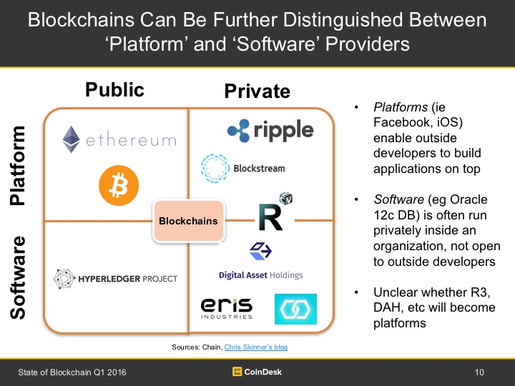
http://www.coindesk.com/state-of-blockchain-q1-2016/

Slide 34

Hyperledger - project
Let’s watch 2 videos!
Video: What is Hyperledger Fabric?
    What is Hyperledger Fabric.mp4
Video: Which Blockchain Technology to Choose?
    Ethereum vs Hyperledger.mp4

Slide 35

R3 - Project (Private)
Software/Platform
Consortium of 50 of the largest banks in the world
Corda Project - the distributed ledger for all 50 banks
Let’s watch a video!
Corda.mp4

Slide 36

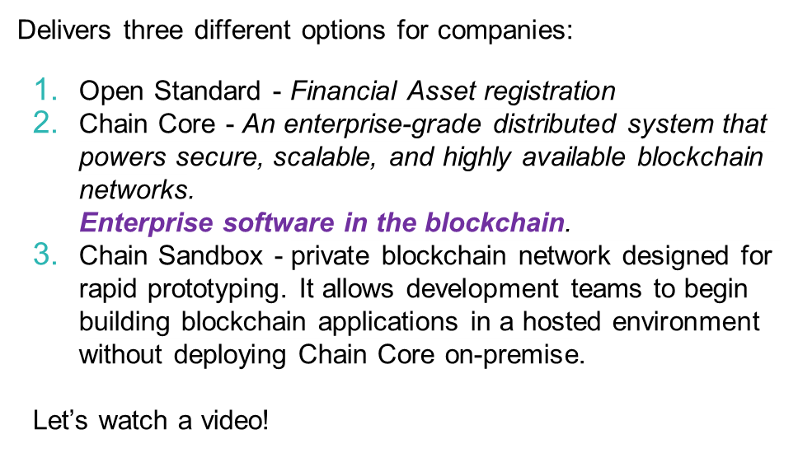
Chain.com (Private)
Introduction to Chain.mp4

Slide 37









END !
Hindi
Traditional Chinese
Thai
Gracias
Russian
Thank You
Spanish
Obrigado
English
Brazilian Portuguese
Arabic
Danke
Grazie
Italian
German
Merci
Simplified Chinese
French
Tamil
Japanese
Korean

Slide 38
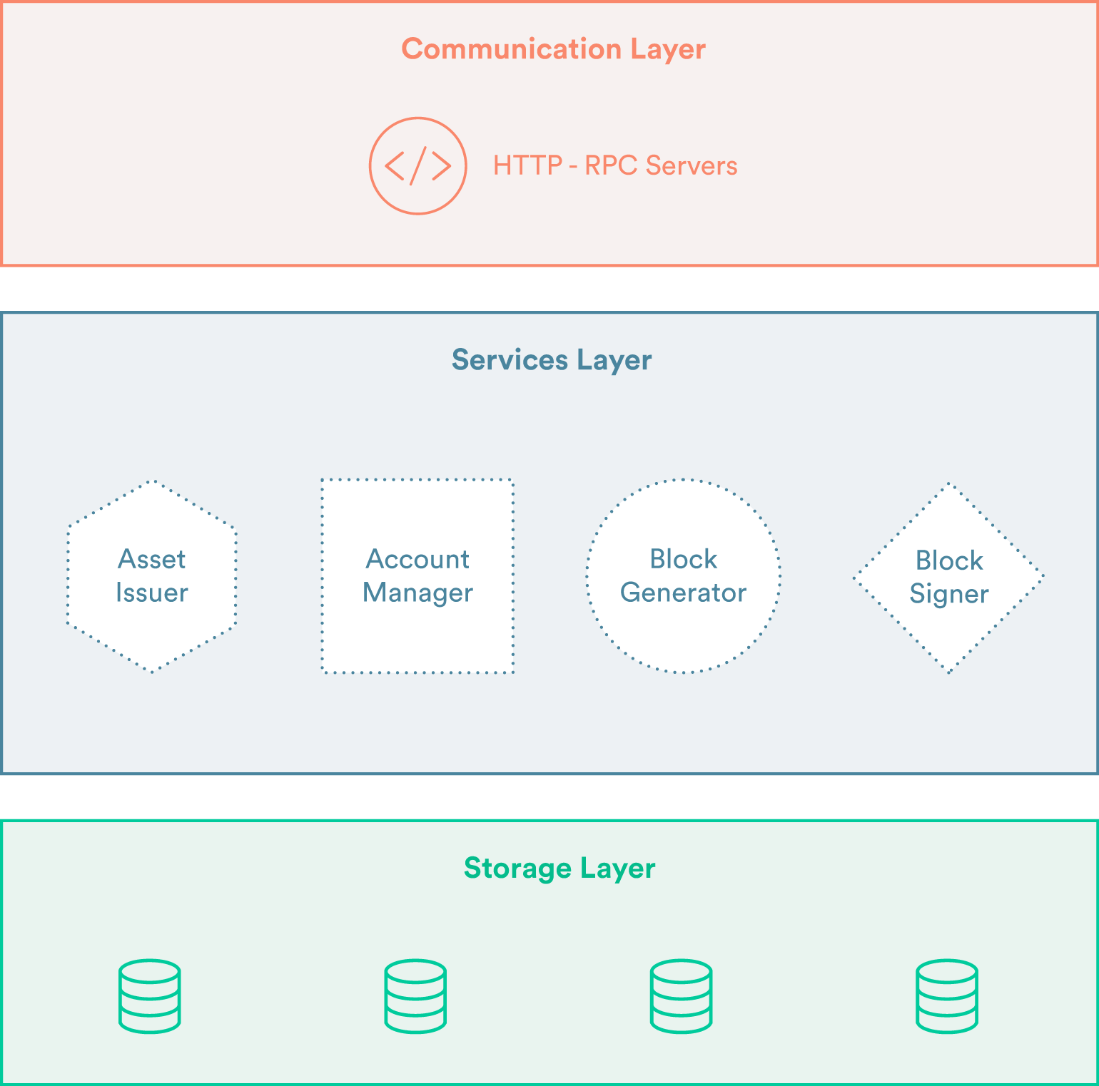
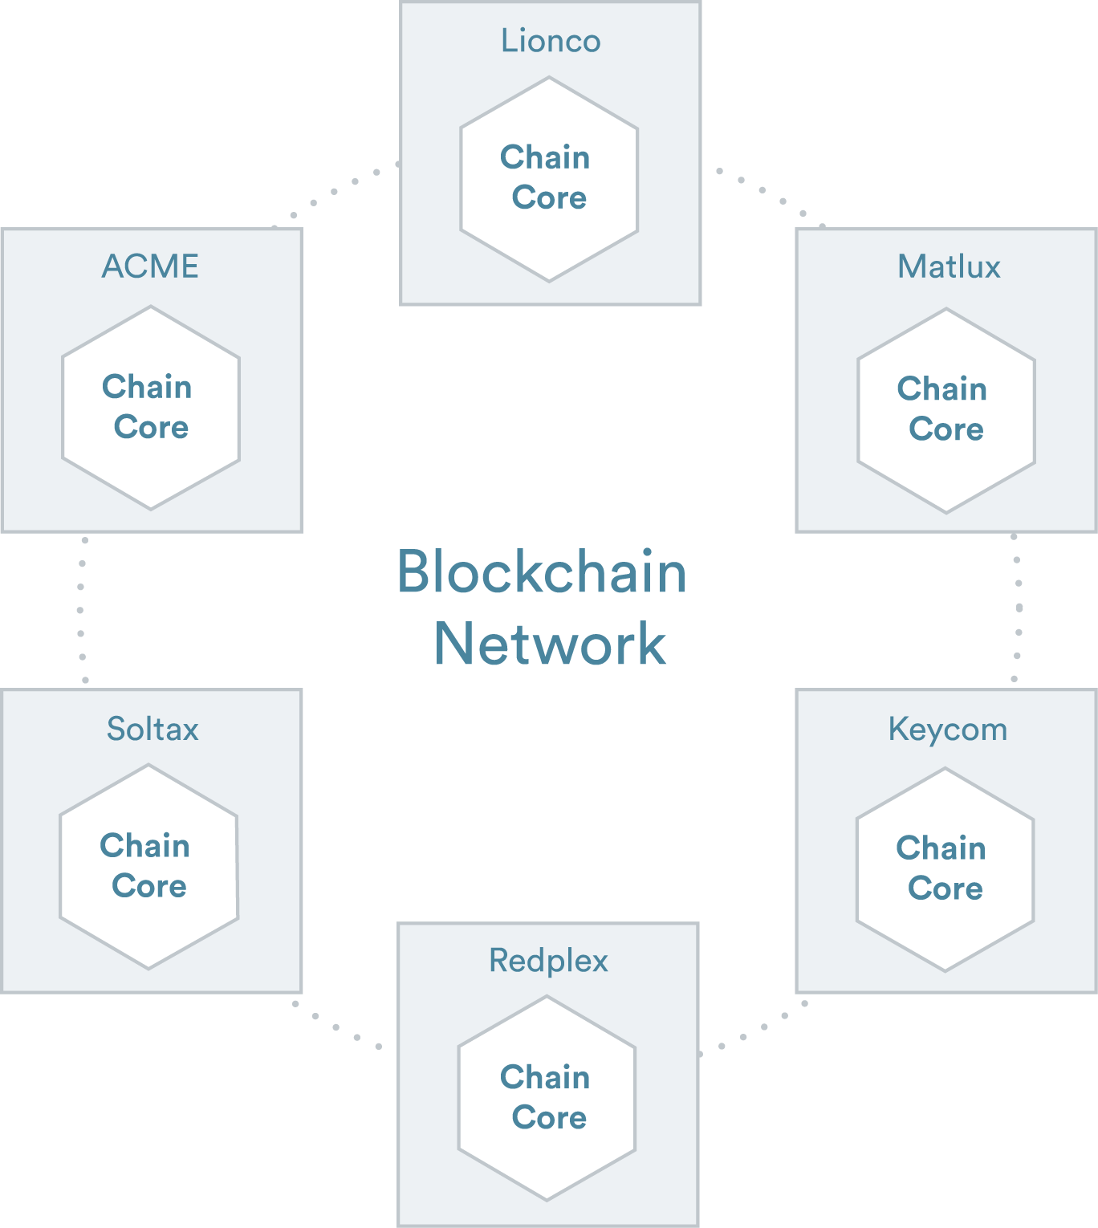
Chain Core
Notes:
Real enterprise software approach to the system.
Communication layer - let the chain system communicate with existing enterprise software
Services Layer - Robust, scalable services that index blockchain data, participate in consensus, validate transactions, and execute smart contracts.
Storage Layer - Horizontally scalable, highly available database cluster that houses blockchain and account data.

